Slide 1
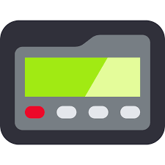
Interruptions on the Medical Units
Bertha Lee, PhD, RN and Anuj K. Dalal, MD
team work
appreciation
“Distractions and interruptions consist of anything that disrupts an individual from the current task by diverting one's attention.”
(Beyea, S., Agency for Healthcare Research and Quality, 2014)
listening
FAST FACTS on Workplace INTERRUPTIONS
STRATEGIES FOR MANAGING DISTRACTIONS
collegiality
A person spends an average of 11 minutes on a task before being interrupted
Work interruptions can cost you at least 6 hours a day
After 1 interruption, refocusing your efforts can take on average 25 minutes
Even after a 2.8-second interruption, error rates doubled
Frequently interrupted workers reported 9% higher exhaustion rates (12% due to work overload)
Effects of work interruptions cost an estimated $588 billion a year in the U.S.
(Westbrook, BMJ Quality and Safety, 2010)
AVOID MULTITASKING
Use a do-not-disturb approach, create a no interruption zone, close doors
SCHEDULE TIME for necessary interruptions
Set expectations with colleagues, patients, your friends and family
USE CHECKLIST APPROACH for high risk, cognitively intense procedures when focus is critical
Admissions
Procedures
Transfer/hand-off
Discharge
interprofessional
mutual respect
understanding
patient care
communication
learning together
collaboration
Produced by Emily Piper-Vallillo, M.Ed., Marina Zambrotta, M.D., and Helen Shields, M.D.

