Slide 1
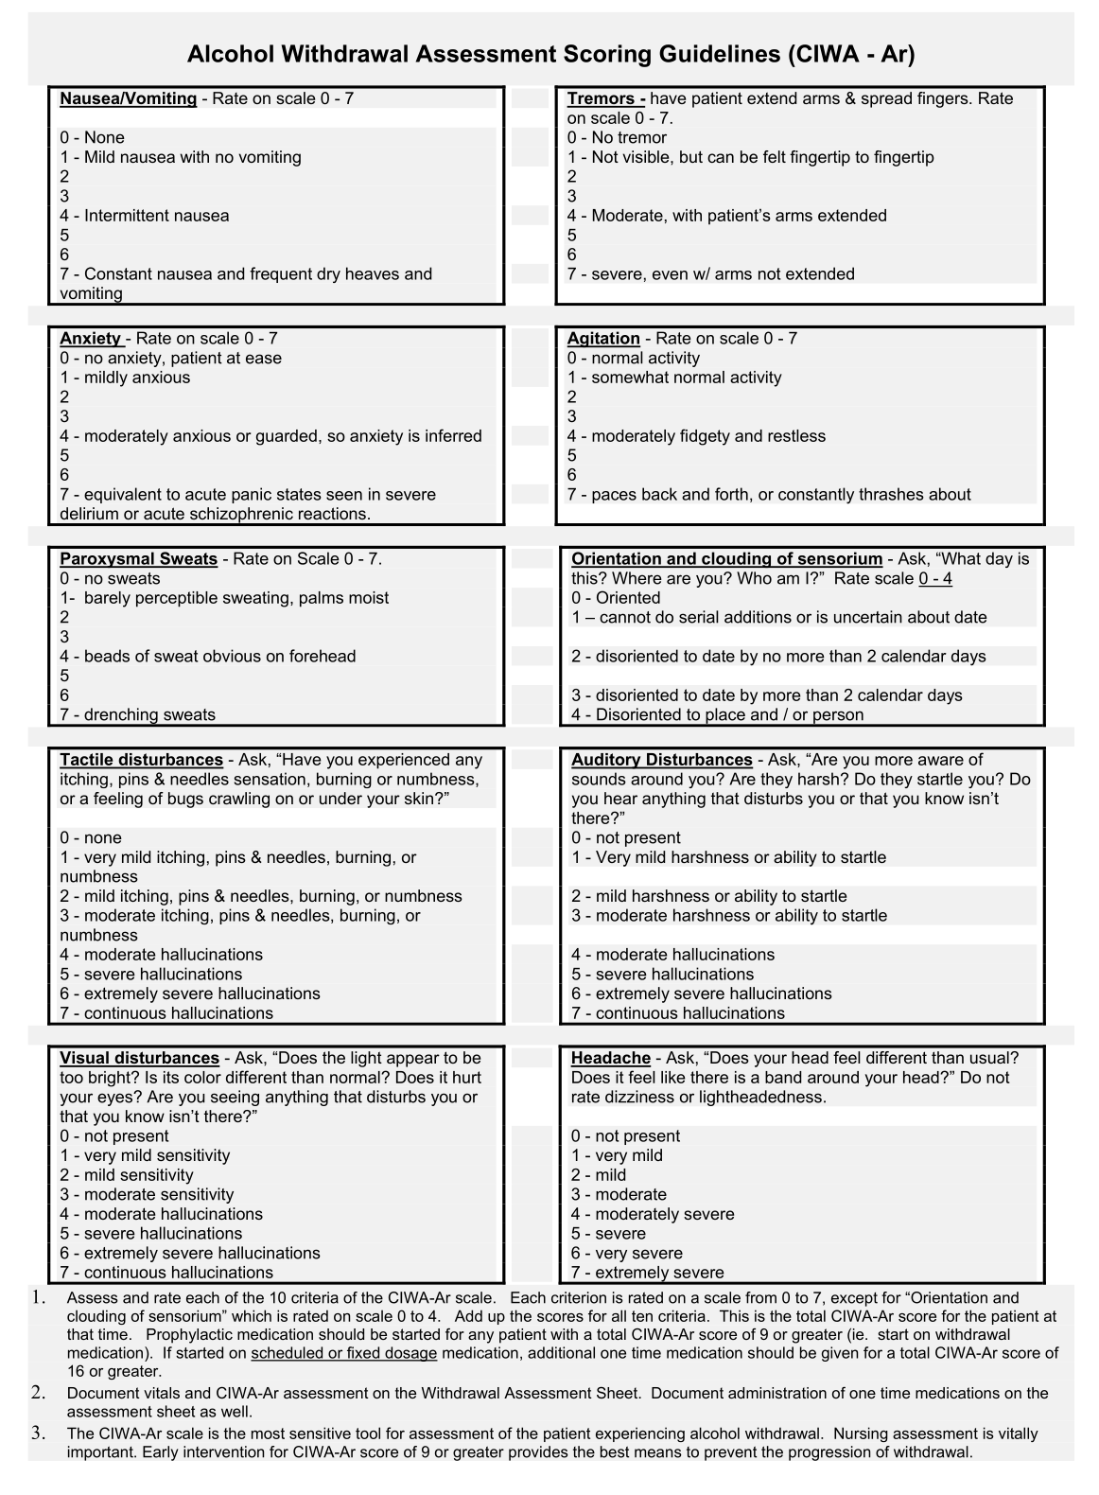
CIWA Co-Teaching Session
February 3, 2020
Holli Murray
Bill Martin-Doyle

Slide 2
Learning Objectives
Describe the signs and symptoms of alcohol withdrawal
Determine who is appropriate for a CIWA-based protocol as compared to a standing regimen
Utilize the CIWA scale to guide symptom-triggered management of alcohol withdrawal

Slide 3
GMS

Slide 4
Video Vignette - Score The CIWA Yourself!
https://www.youtube.com/watch?v=NUKigZjcGy4

Slide 5
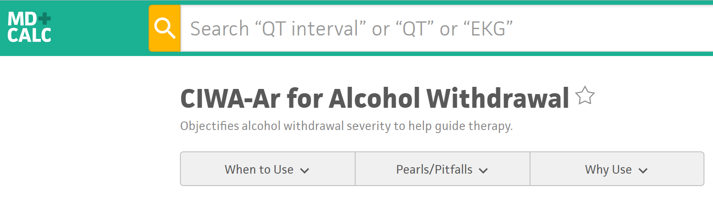
CIWA Scoring
https://www.mdcalc.com/ciwa-ar-alcohol-withdrawal

Slide 6
Vignettes!

Slide 7
Case 1
A 45 year old male is admitted for alcohol withdrawal and ordered for CIWA per protocol every 4 hours
His CIWA scores following admission are:
2mg lorazepam were given for scores 12 and 15. It is now 22:00.
Do you continue the CIWA?
8:00 | 12:00 | 16:00 | 20:00 | 22:00
4 | 5 | 12 | 15 | 17
If the answer is no - stand up!

Slide 8
Case 2
A 70 year old patient with alcohol dependence is admitted for Community Acquired Pneumonia
Patient was initially hypotensive but is now stabilized
PMH includes severe Parkinson’s Disease.
Do you put this patient on CIWA?
If the answer is no - stand up!

Slide 9
Case 3
A 25 year old American Sign Language-speaking deaf patient with alcohol use disorder and no other PMH is admitted for alcohol withdrawal
Do you put this patient on CIWA?
If the answer is no - stand up!

Slide 10
IT’s Time for some SLIDES!

Slide 11
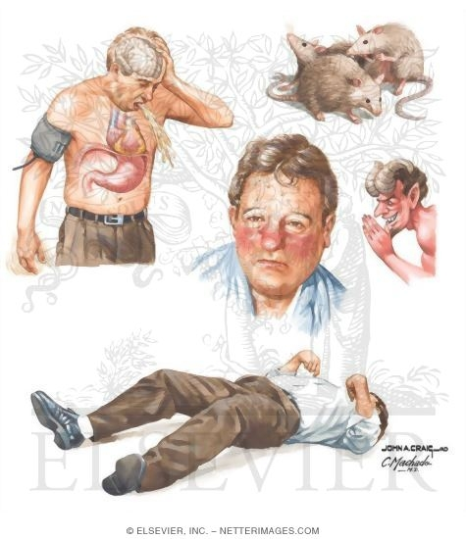
Complications of Alcohol Withdrawal
~80% mild-to-moderate
~20% severe / complicated:
Hallucinations
Seizures
Delirium Tremens
Saitz et al. Med Clin North Am. 1997;81(4):881

Slide 12
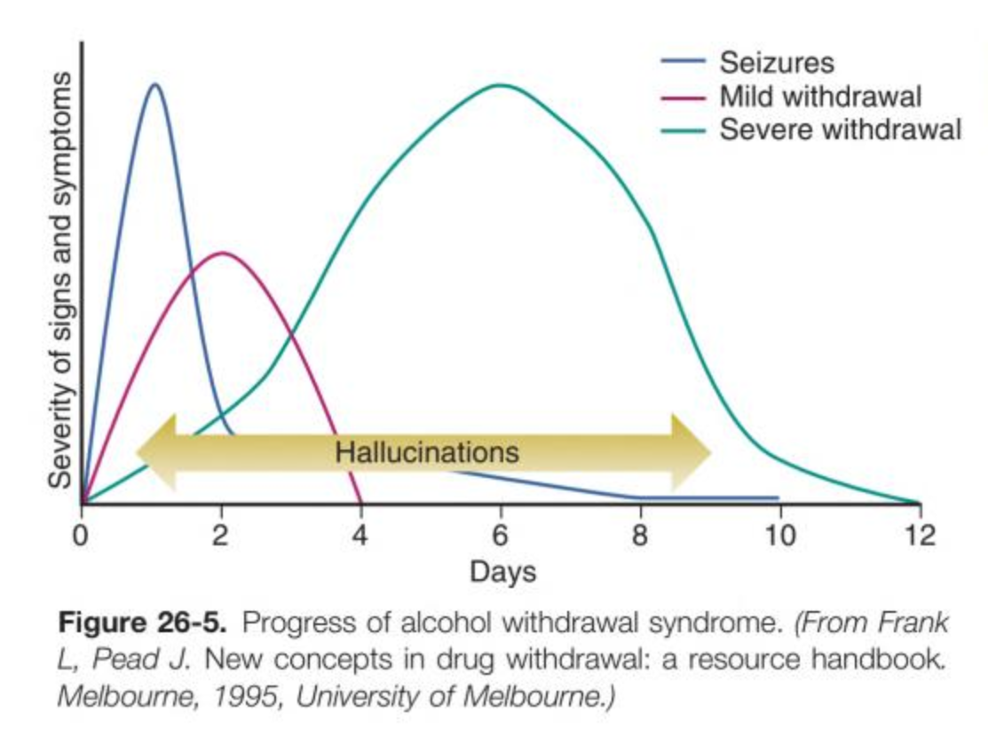
Timeline of Alcohol Withdrawal
Stern TA, et al. Massachusetts General Hospital - Comprehensive Clinical Psychiatry, Second Edition. Elsevier 2016

Slide 13
CIWA Scoring Reduces Duration of Medication Administration and Benzodiazepine Dosing
P<0.001
P<0.001
P<0.001
P<0.001
Hours
Mg
N=101
N=117
N=101
N=117
CIWA-triggered dosing
Standing / fixed-dose regimen

Slide 14
Questions?

Slide 15
Thank You!!!

Slide 16
Additional slides

Slide 17
Signs and Symptoms of Alcohol Withdrawal
Nausea/vomiting
Headache
Anxiety
Tremor
Diaphoresis
Agitation
Restlessness
Change in VS: Increased BP, HR, RR
Confusion
Delirium
Hallucinations
Seizures
Delirium Tremens
Modified from BWH Psychiatric Resource Nursing Service “BWH Alcohol Withdrawal: Risk Assessment and Treatment”

Slide 18
When You Should Consider Standing Regimen
History of severe withdrawal
(delirium tremens, withdrawal seizure)
Patient already in severe alcohol withdrawal
(presenting with DTs and/or seizures)
Patient unable to communicate
Comorbidities Making CIWA Scoring Difficult
CIWA ≥ 16

Slide 19
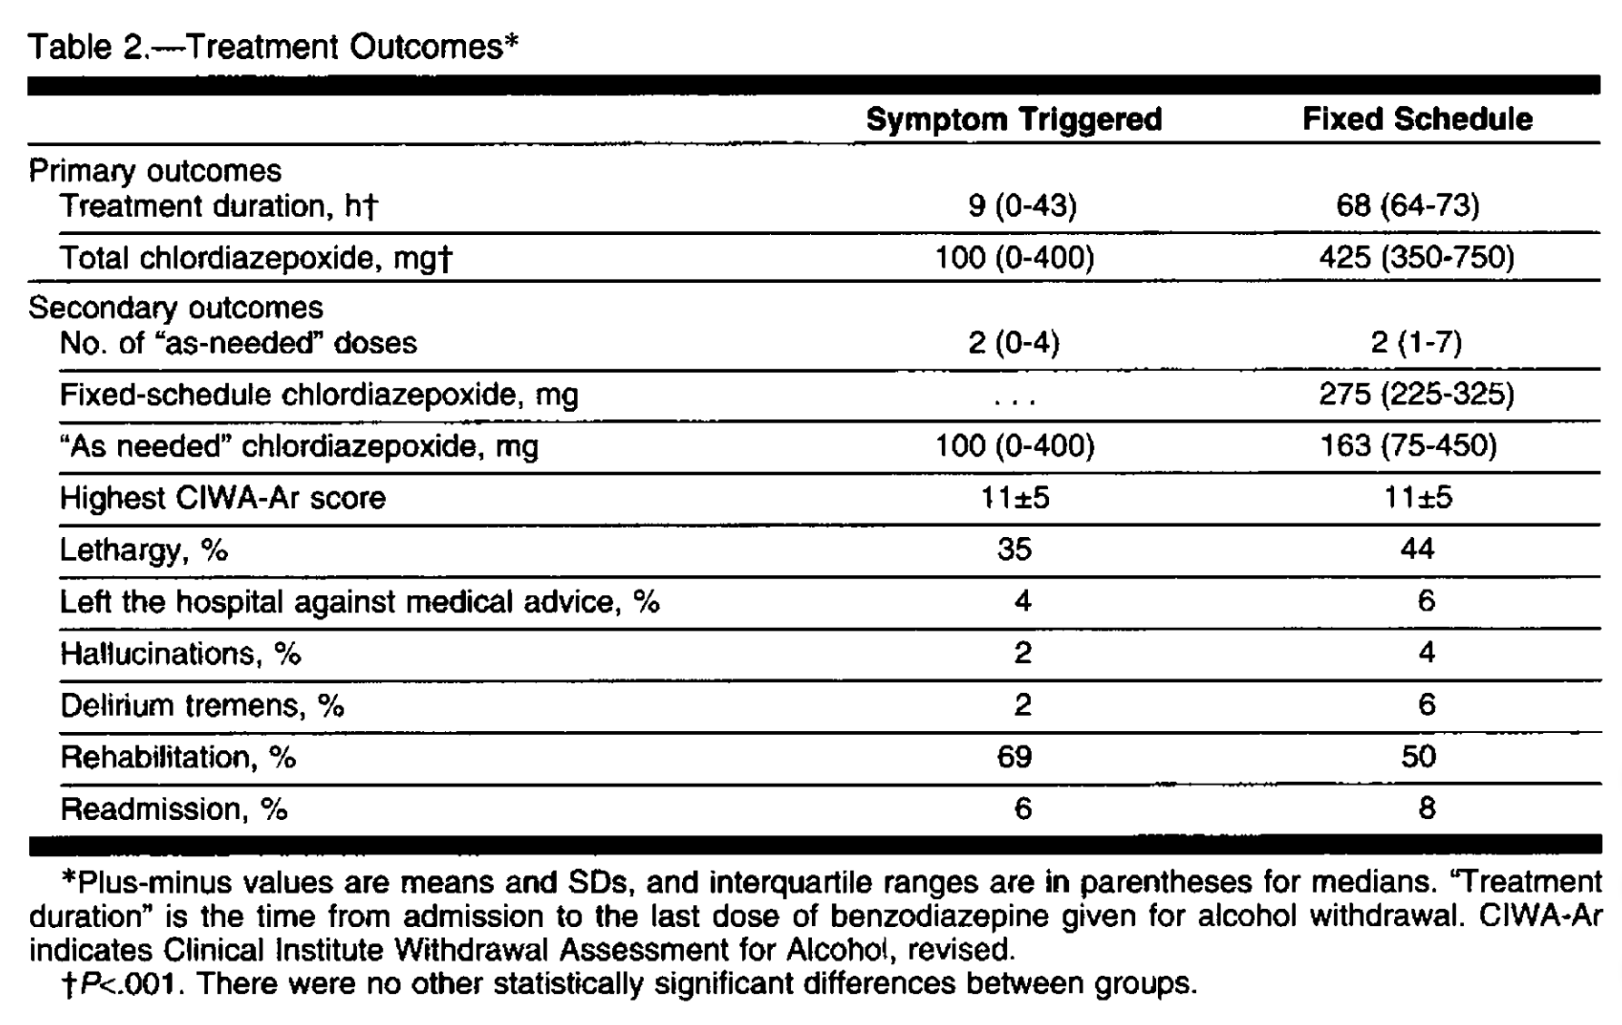
CIWA-Ar Outcomes vs Symptom Triggered
N=51
N=50
p<0.001
p<0.001

Slide 20
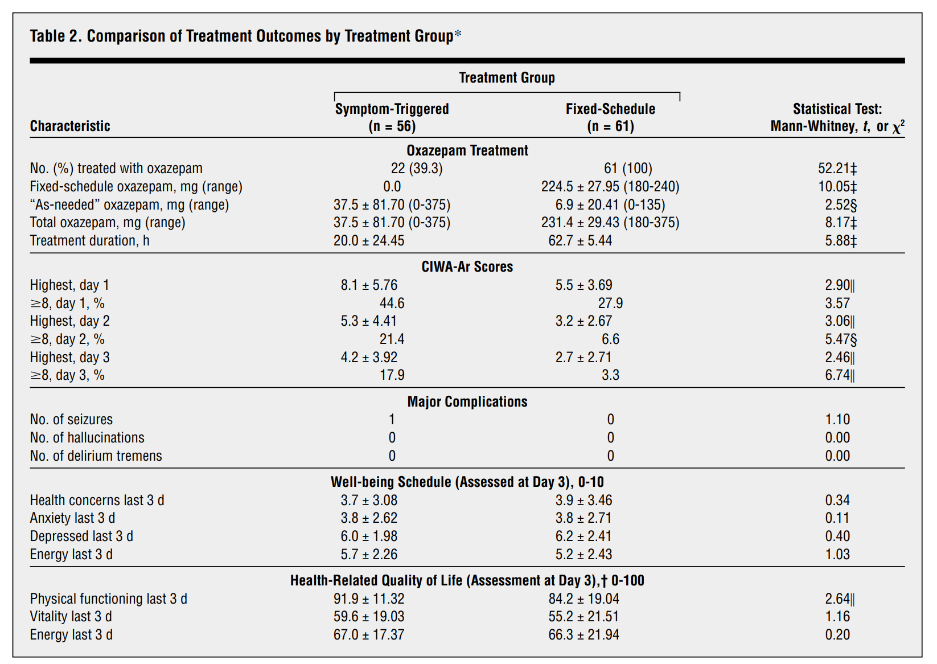
CIWA-Ar Outcomes vs Symptom Triggered
p<0.001
p<0.001

Slide 21
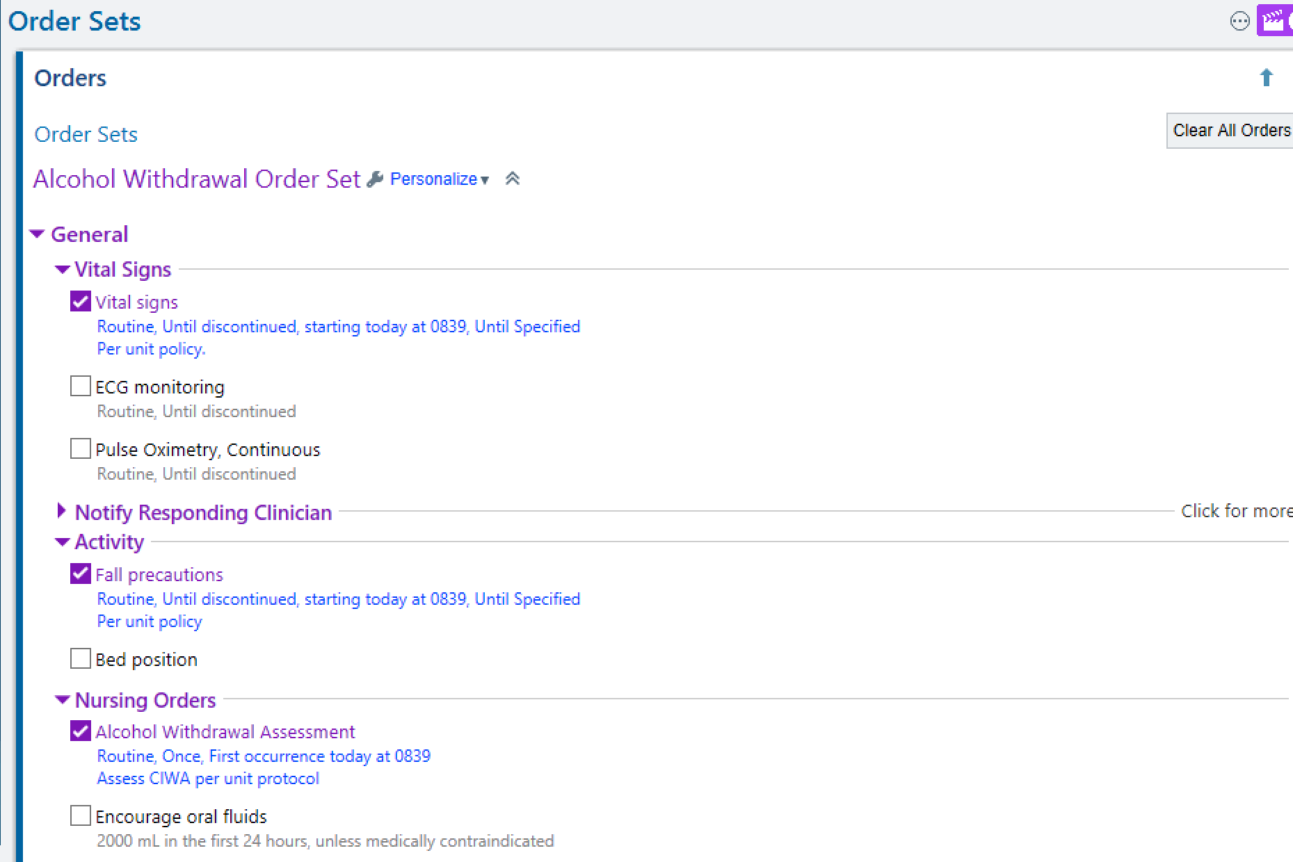
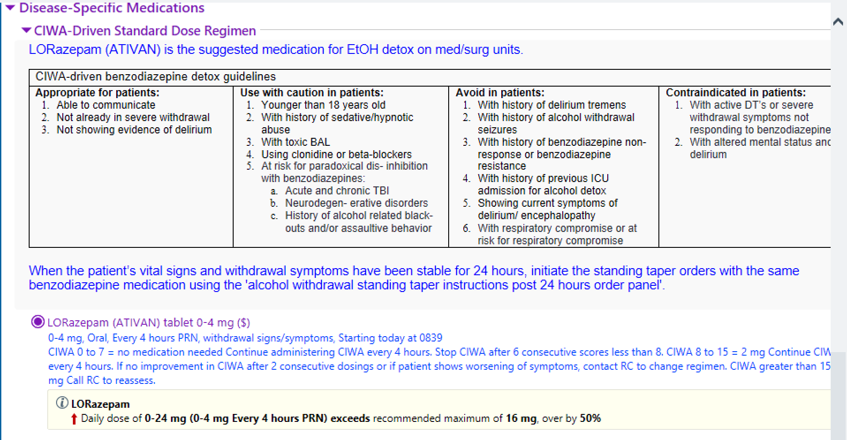
Where to find Epic Alcohol Withdrawal Orders
1
Order sets:
alcohol withdrawal
2
Ativan per CIWA: standard vs low dose;
IV vs PO
3
Thiamine, MVI, Folate

Slide 22
What is the CIWA-Ar Scale?
Clinical Institutes Withdrawal Assessment Scale for Alcohol (CIWA-Ar)
“Symptom-triggered therapy”
Studied primarily in moderate severity withdrawal (i.e., no seizures, DTs, able to take PO, no severe comorbidities…)
Ten areas to assess and score (0-7 each), total score of 67
Mild: 0-8
Moderate: 9-15
Severe: > 16, higher risk seizure/DTs
Benefits compared to standing regimen:
Reduced total amount of benzodiazepines administered
Shorter duration of treatment

